Slide 1
Transfer learning - or how to exploit a pre-trained convnet

Slide 2
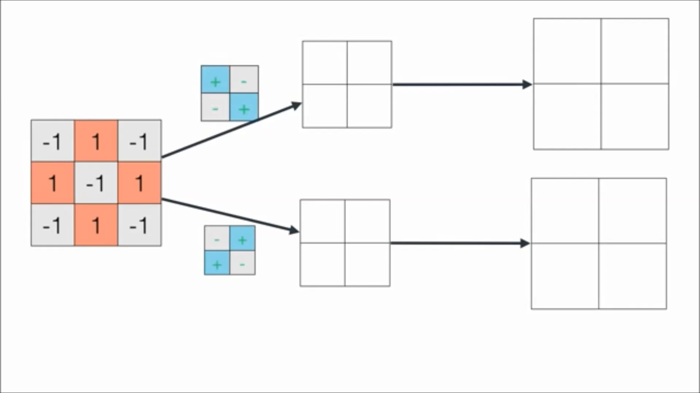
2D Convolution: degree of similarity (i.e. dot product) between a filter/kernel and each patch of an image to generate as output a feature map
Original
Image
Computer representation of the image
Kernels/Filters
Feature maps
Presence of features in original image
Notes:
The feature map indicates the degree of similarity between the kernel and the different patches of the image

Slide 3
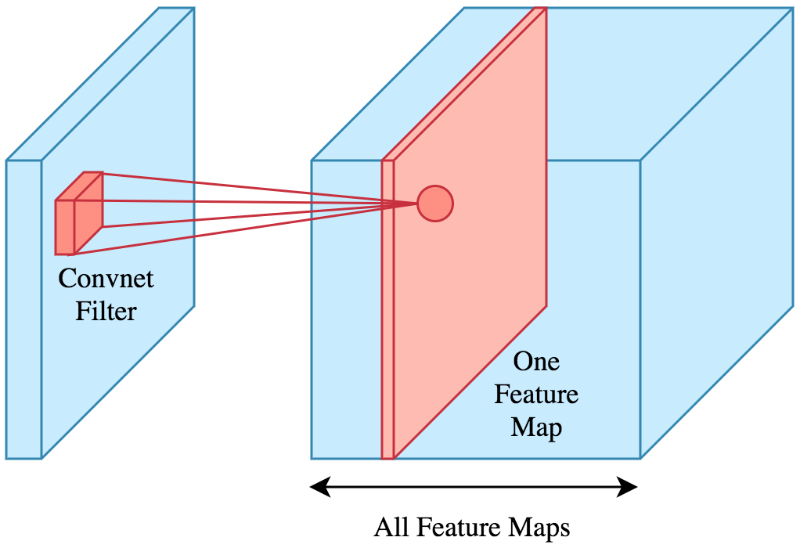
Each convolution layer generates as output several feature maps

Slide 4

Recap that a convolutional neural networks architecture is just a concatenation of convolution and pooling layers that ends up in one or more fully connected layers

Slide 5
Example Architecture: Overview
A simple ConvNet for Image classification could have the architecture:
[INPUT - CONV - RELU - POOL - FC].
In more detail:
INPUT [32x32x3] will hold the raw pixel values of the image, in this case an image of width 32, height 32, and with three color channels R,G,B.
CONV layer will compute the output of neurons that are connected to local regions in the input, each computing a dot product between their weights and a small region they are connected to in the input volume. This may result in a volume such as [32x32x12] if we decided to use 12 filters/kernels.
RELU layer will apply an elementwise activation function, such as the max(0,x) thresholding at zero. This leaves the size of the volume unchanged ([32x32x12]).
POOL layer will perform a downsampling operation along the spatial dimensions (width, height), resulting in volume such as [16x16x12].
FC (i.e. fully-connected) layer will compute the class scores, resulting in volume of size [1x1x10], where each of the 10 numbers correspond to a class score, such as among the 10 categories of CIFAR-10. As with ordinary Neural Networks and as the name implies, each neuron in this layer will be connected to all the neurons in the previous layer.

Slide 6
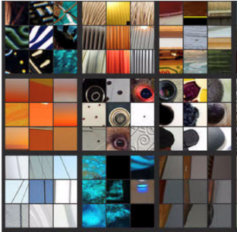
What are deep convolutional networks learning?
We can look at what are the image patches that maximize a unit's activation?
So in other words pass your training set through your neural network, and figure out what is the image that maximizes that particular unit's activation.
Layer 1
Layer 2
Layer 3
Layer 4
Layer 5

Slide 7
Visualizing deep layers: Layer 1
Layer 1
Layer 2
Layer 3
Layer 4
Layer 5
The first layers learn low level features about an image: vertical, horizontal, diagonal edges and textures.

Slide 8
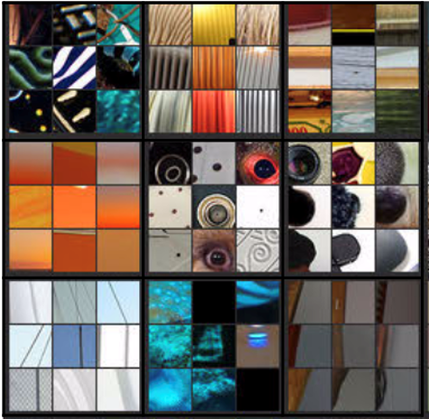
Visualizing deep layers: Layer 2
Layer 1
Layer 2
Layer 3
Layer 4
Layer 5
later layers learn higher level features about an image

Slide 9
Visualizing deep layers: Layer 3
Layer 1
Layer 2
Layer 3
Layer 4
Layer 5

Slide 10
Visualizing deep layers: Layer 4
Layer 1
Layer 2
Layer 3
Layer 4
Layer 5

Slide 11
Visualizing deep layers: Layer 5
Layer 1
Layer 2
Layer 3
Layer 4
Layer 5

Slide 12
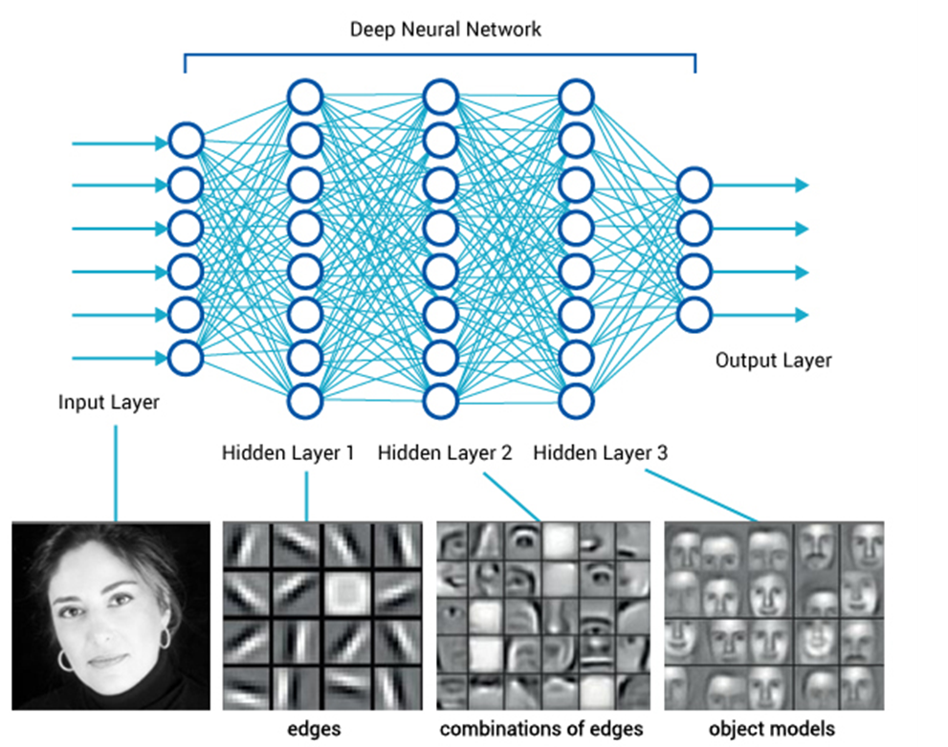

Why parameters sharing makes sense
If detecting a horizontal edge is important at some location in the image, it should intuitively be useful at some other location as well due to the translationally-invariant structure of images.
There is therefore no need to relearn to detect a horizontal edge at every one of the distinct locations in the Conv layer output volume
This makes this networks computationally very efficient
Significant biological resemblance with the visual system of the neocortex
What about parameter sharing for different models?

Slide 13
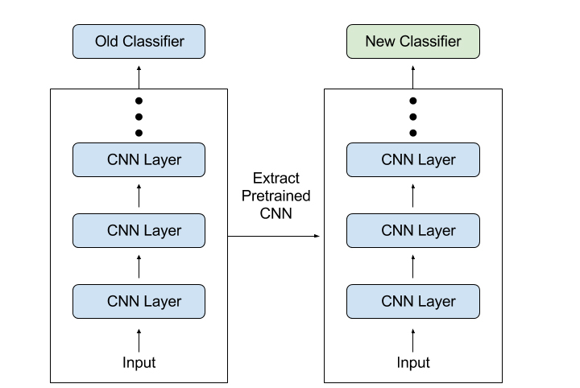
Transfer learning
Frozen (i.e. no back propagation)
Pretrained model
New model

Slide 14
Transfer learning
A common and highly effective approach to deep learning when you have little amounts of data to train with is to use a pretrained network.
A pretrained network is a saved network that was been previously trained on a large dataset, for instance on a large-scale image-classification task.
If this original dataset is large enough and general enough, then the spatial hierarchy of features (edges, textures,…) learned by the pretrained network can effectively act as a generic model of the visual world, and hence its features can prove useful for many different computer vision problems
Even though these new problems may involve completely different classes than those of the original task.

Slide 15
Transfer learning
For instance, you might train a network on ImageNet (where classes are mostly animals and everyday objects) and then repurpose this trained network for something as remote as identifying furniture items in images.
ImageNet dataset: 1.4 million labeled images and 1,000 different classes
Such portability of learned features across different problems is a key advantage of deep learning compared to many older, shallow-learning approaches, and it makes deep learning very effective for small-data problems.

Slide 16

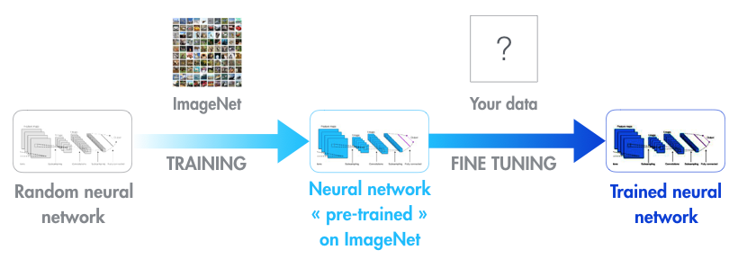
Transfer learning
Modern object recognition models have millions of parameters and can take weeks to fully train in large computer clusters.
In practice, very few people train an entire Convolutional Network from scratch (with random initialization)
because it is relatively rare to have a dataset of sufficient size
And because it is computationally very expensive.
Instead, it is common to use a ConvNet pretrainned on a very large dataset (e.g. ImageNet, which contains 1.2 million images with 1000 categories), and then use the ConvNet either as an initialization or a fixed feature extractor for the task of interest.
Transfer learning takes a fully-trained model for a set of categories like ImageNet, and retrains from the existing weights for new classes only on the last fully connected layer of the network
ImageNet does not need to contain your new classes. However, the kinds of information/features (horizontal/vertical edges, etc) that make it possible for ImageNet to differentiate among its original1,000 classes are also useful for distinguishing other objects.

Slide 17
Feature extraction
Feature extraction consists of using the representations learned by a previous network to extract interesting features from new samples
These features are then run through a new classifier, which is trained from scratch
So in essence you are just swapping the last densely connected layers of the network while keeping the same convolutional base

Slide 18
Could you reuse the densely connected classifier as well?
In general, doing so should be avoided.
The reason is that the representations learned by the convolutional base are likely to be more generic and therefore more reusable
the feature maps of a convnet are presence maps of generic concepts over a picture, which is likely to be useful regardless of the computer-vision problem at hand.
But the representations learned by the densely connected layer classifier will necessarily be specific to the set of classes on which the model was trained—they will only contain information about the presence probability of this or that class in the entire picture.
Additionally, representations found in densely connected layers no longer contain any information about where objects are located in the input image: these layers get rid of the notion of space, whereas the object location is still described by convolutional feature maps.
For problems where object location matters, densely connected features are largely useless.
Note that the level of generality (and therefore reusability) of the representations extracted by specific convolution layers depends on the depth of the layer in the model.
Layers that come earlier in the model extract local, highly generic feature maps (such as visual edges, colors, and textures), whereas layers that are higher up extract more-abstract concepts (such as “cat ear” or “dog eye”).
So if your new dataset differs a lot from the dataset on which the original model was trained, you may be better off using only the first few layers of the model to do feature extraction, rather than using the entire convolutional base.

Slide 19
Prize-winning image classification models available in Keras
All pre-trained on the ImageNet data set
Inception V3
Xception
VGG16
VGG19
MobileNet
ResNet50

Slide 20
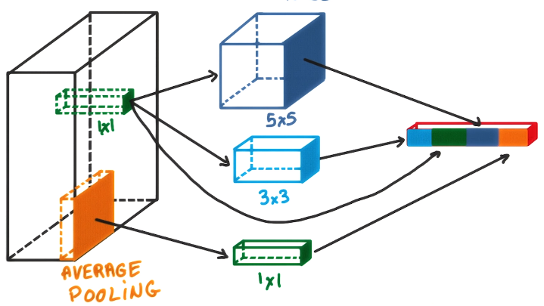
Inception modules
Models that use several convolutions work better than models using a single convolution

Slide 21
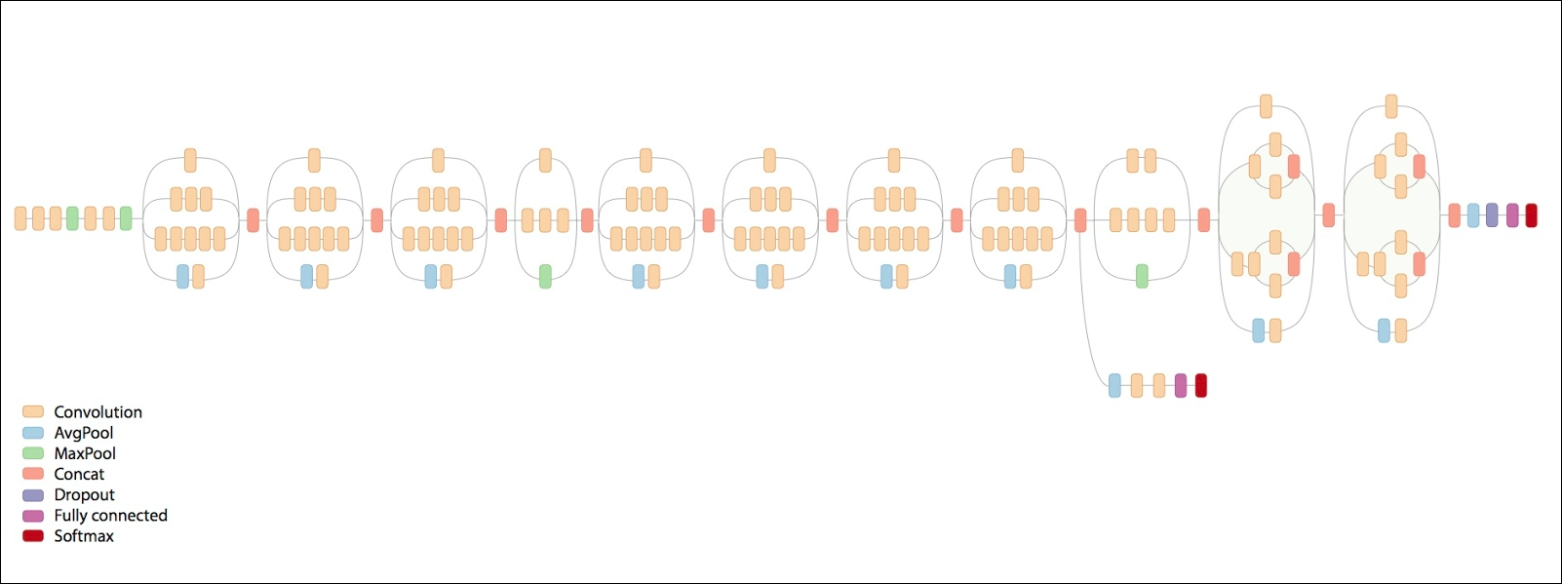
Inception v3 – almost state-of-the-art machine vision

Slide 22
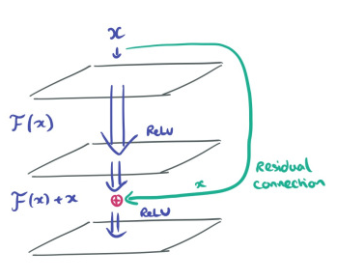
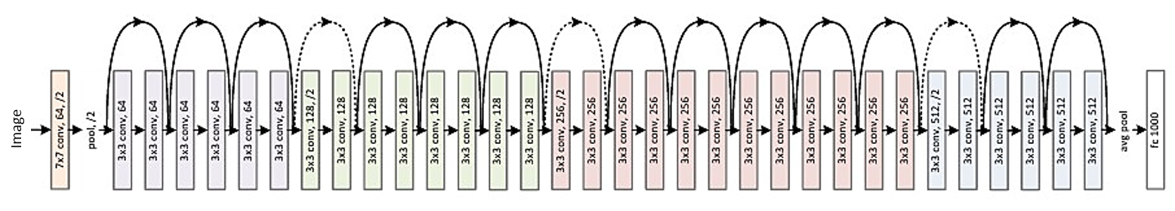
Residual Networks (ResNets)
Very, very deep neural networks are difficult to train because of vanishing and exploding gradient types of problems.
skip connections which take the activation from one layer and feed it to another layer even much deeper in the neural network in order to mitigate the vanishing or exploding gradient problem.
This is the fundamental principle of residual networks (ResNet) which enables you to train very, very deep networks.

Slide 23
Why does transfer learning matter?
Re-using previously acquired knowledge reduces the amount of data a model needs in order to learn a new task.
A model pre-trained on many different problems will internalise an increasingly rich understanding of the world and is therefore considered a key step towards generalising AI.
Example: Repurposing Google’s InceptionV3 image recognition network for skin cancer detection
Transfer learning enabled automatic state-of-the-art detection of dangerous skin lesions on human patients
The Google InceptionV3 network was first trained on ImageNet and then re-trained with 129,450 clinical images of 2,032 different skin diseases. It learns how to classify images based on pixel inputs and disease labels only.
The model outperforms 21 Stanford dermatologists
Notes:
In the charts, you’ll see that the majority
of red points (dermatologist) reside below the blue
curve (sensitivity-specificity for the model). This
means the model achieves superior performance
compared to dermatologists.

Slide 24
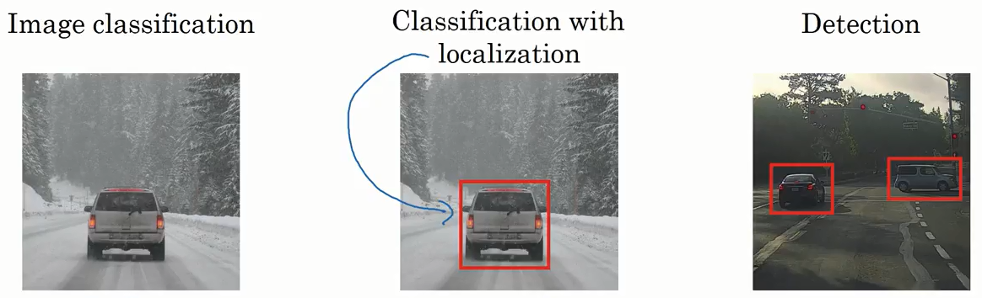
More computer vision tasks
Car at coordinates (x,y)
Car 1 at coordinates (x₁,y₁)
Car 2 at coordinates (x₂,y₂)
Car

Slide 25
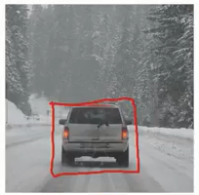
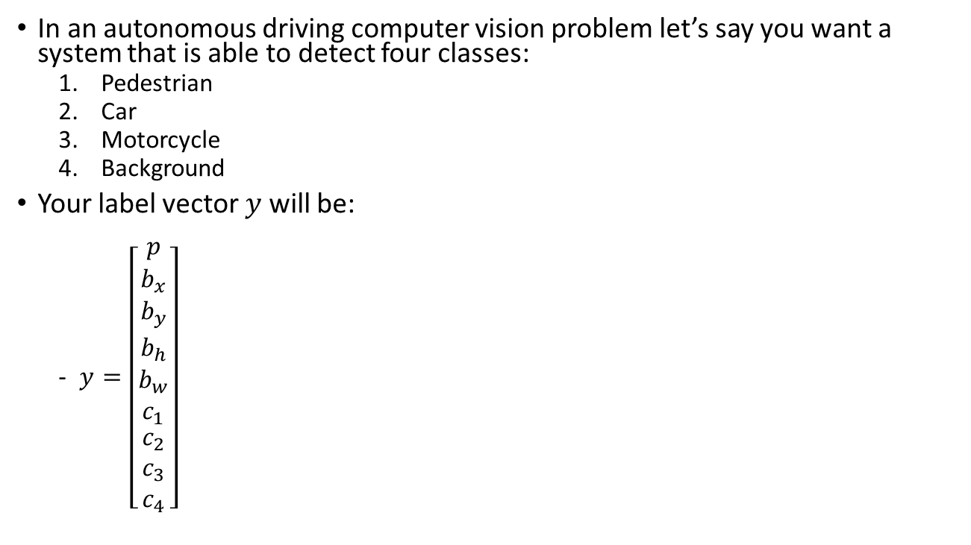
Defining the target label y in object localization
In an autonomous driving computer vision problem let’s say you want a system that is able to detect four classes:
Pedestrian
Car
Motorcycle
Background
Your label vector $y$ will be:
$y=\left[\begin{matrix}p \\ b_{x} \\ \begin{matrix}b_{y} \\ b_{h} \\ \begin{matrix}b_{w} \\ c_{1} \\ \begin{matrix}c_{2} \\ c_{3} \\ c_{4}\end{matrix}\end{matrix}\end{matrix}\end{matrix}\right]$
Is there an object in the image?
Bounding box coordinate x
Bounding box coordinate y
Bounding box height
Bounding box width
Class pedestrian
Class car
Class motorcycle
Class background

Slide 26
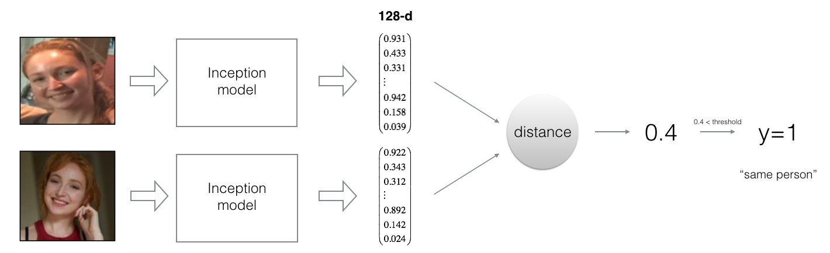
Face verification/recognition using neural network encoding
The computer vision models outputs a matrix of shape (m,128)(m,128) that encodes each input face image into a 128-dimensional vector
You then use the encodings the compare two face

Slide 27
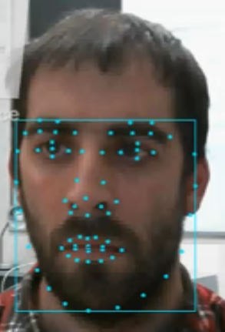
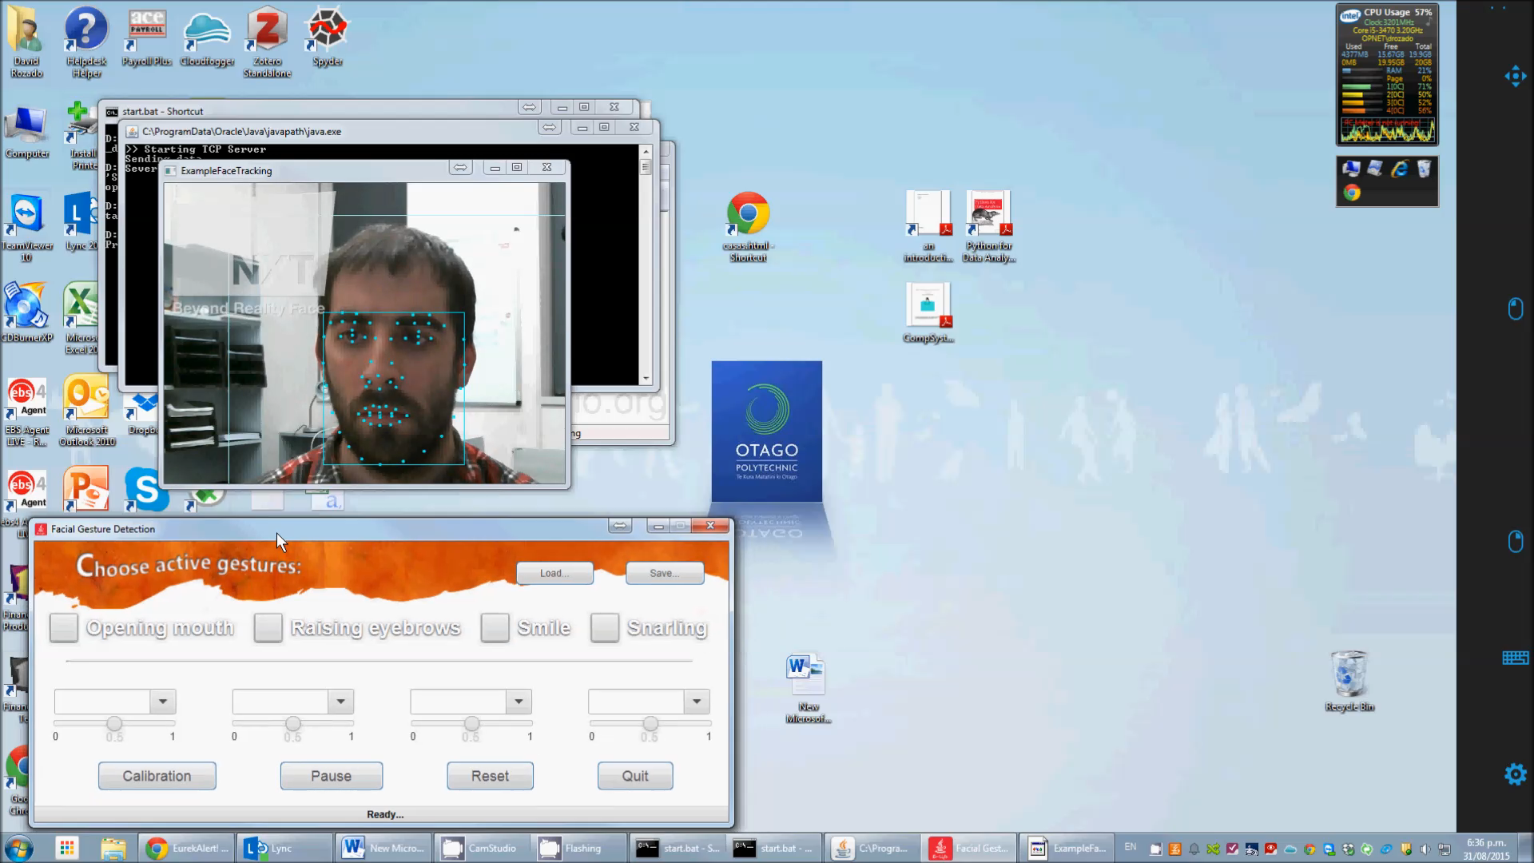
Object tracking

Slide 28
Today’s Practicals
Practical 1 – Transfer learning
Practical 2 – Object tracking in a video stream
Practical 3 – Face verification and recognition
Practical 4 – Autonomous driving cars
You are only responsible for Practicals 1 and 2!!!
That is, their content is related to some questions in Assignment 2
Practicals 2 and 3 are a bit advanced and you should not stress yourself about them
They are provided for those of you who are curious about the topic of computer vision and want to explore the state of the art in the field

